Slide 1
Lecture 3 REMOTE SENSING DATA
SPECTRAL SIGNATURE
VEGETATION, SOIL, WATER

Slide 2
SUMMARY OF LECTURE 1 and 2
Remote Sensing and its component
Planck’s Law, peak emittance from sun and earth
Peak wavelength from sun and earth
Remote sensing type: Based on em spectrum or source
Advantages of Remote sensing
Measured quantity and instruments
Panchromatic, Natural color composite and false color composite

Slide 3
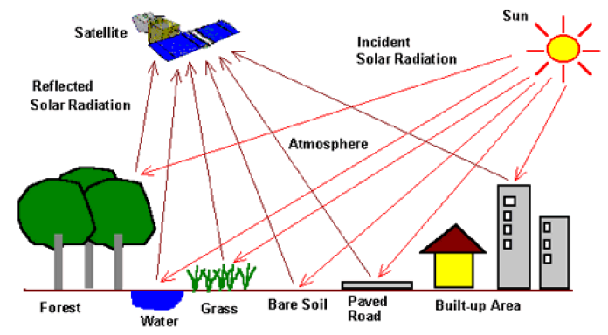
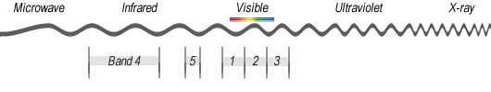
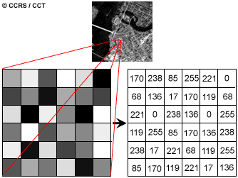
WHAT IS REMOTE SENSING DATA
A TWO DIMENSIONAL DISTRIBUTION
OF REFLECTED ENERGY

Slide 4
REMOTE SENING DATA COLLECTION METHODS
OPTICAL/IR REMOTE SENSING
PANCHROMATIC
MULTISPECTRAL
HYPERSPECTRAL

Slide 5
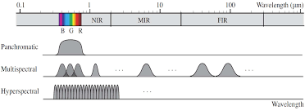
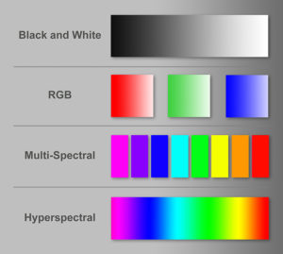
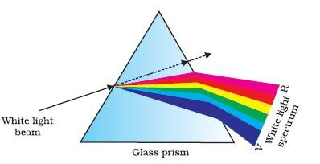

Slide 6
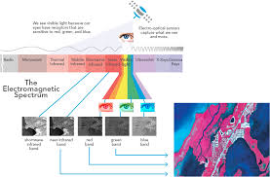

Slide 7
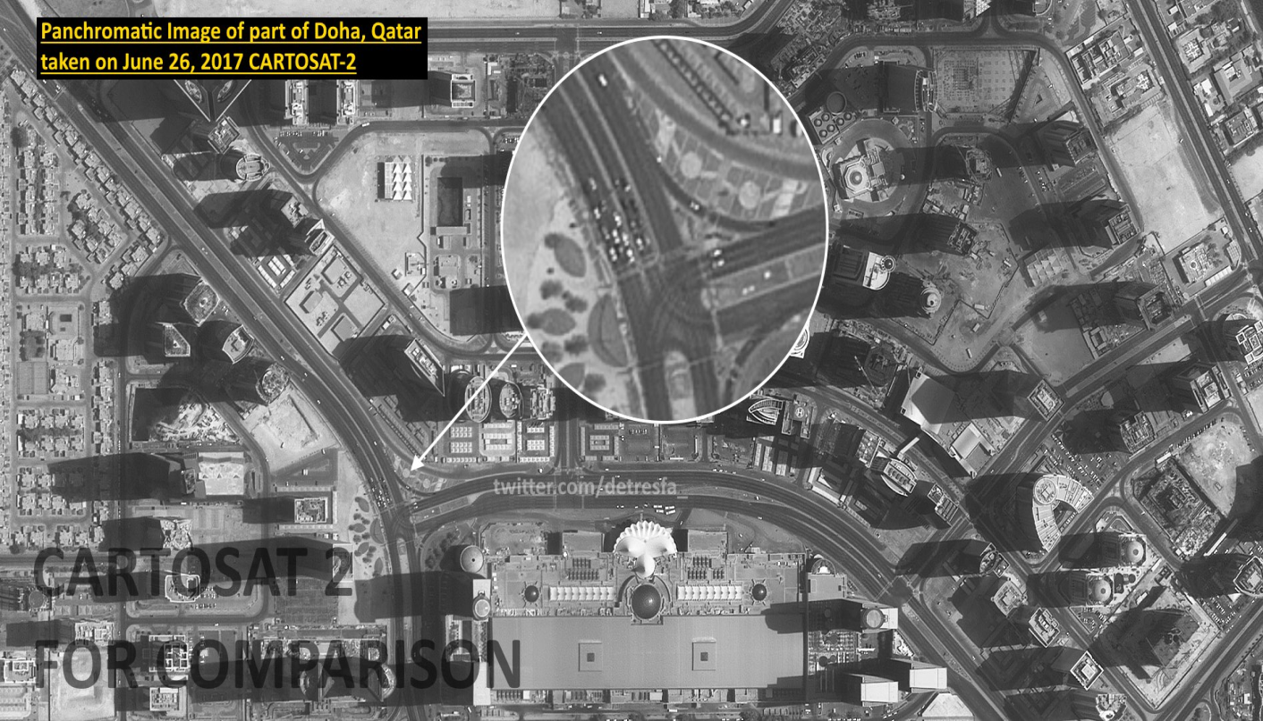
A panchromatic band (black and white band) is one band that usually contains a couple of hundred nanometers bandwidth. The bandwidth enables it to hold a high signal-noise, making the panchromatic data available at a high spatial resolution. This images can be gathered with a higher resolution since the spectral range give the smaller detectors allowance to be utilized while sustaining the high signal-noise ratio.
Advantage:
High SNR
High resolution
Cartosat-3 has a ground
resolution of 0.25 m with
16 km swath
Doha
Cartosat-3
https://eos.com/panchromatic/

Slide 8
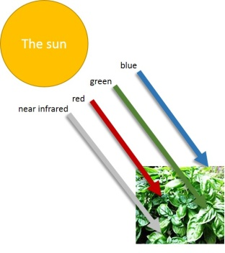
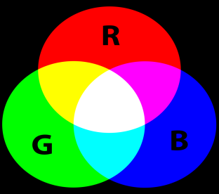
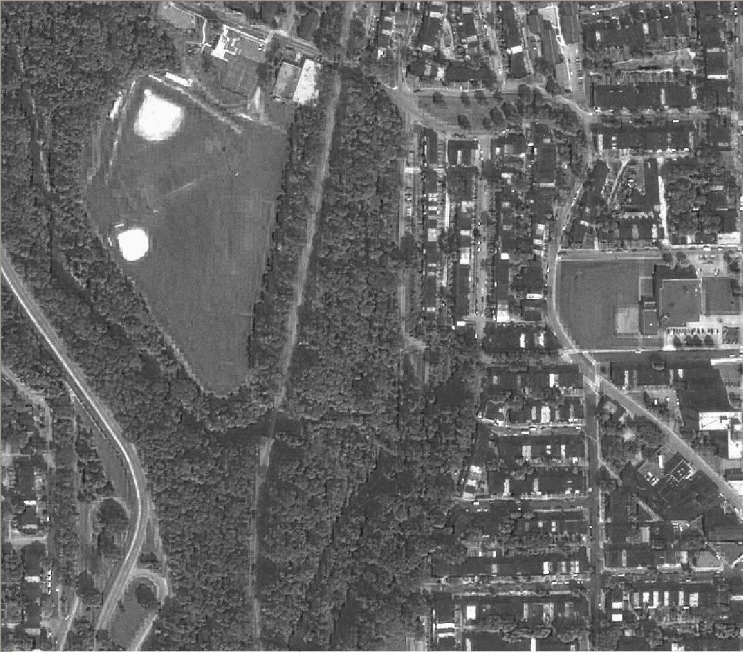
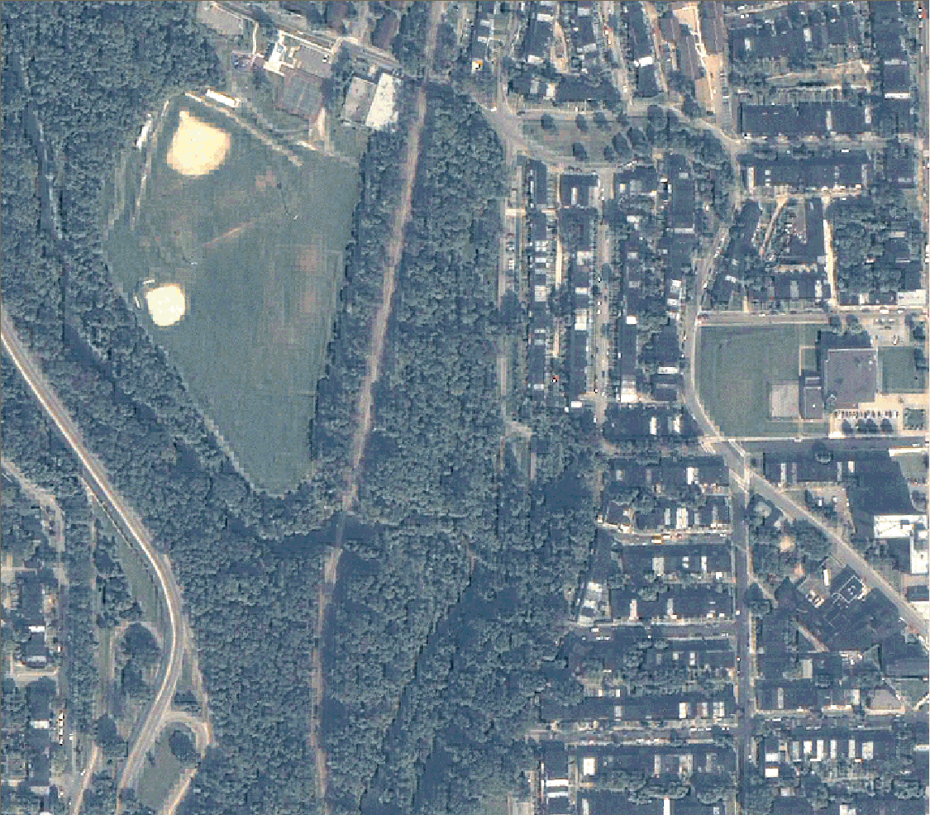
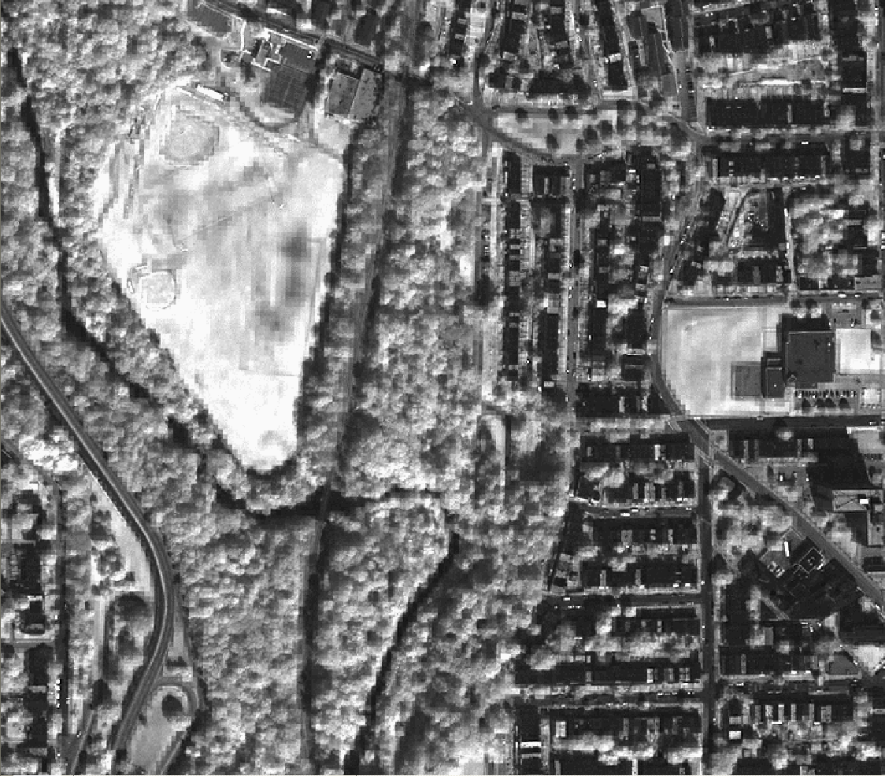
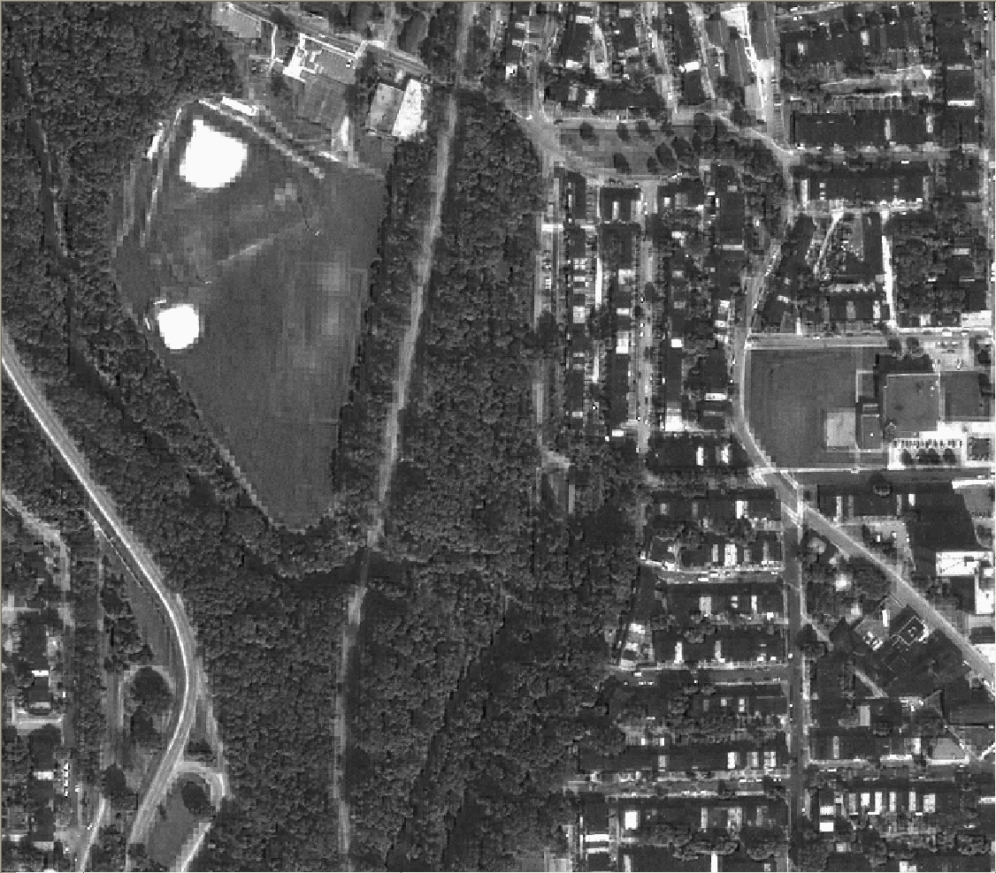
Display of Multispectral Image
NATURAL color composite
Bands
Applied to color
Resulting Image
Red
Green
Blue

Slide 9
WHAT IS REMOTE SENSING DATA
A TWO DIMENSIONAL DISTRIBUTION
OF REFLECTED ENERGY

Slide 10
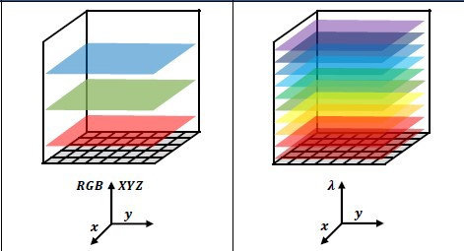
Resulting Image

Slide 11
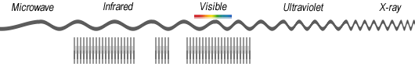
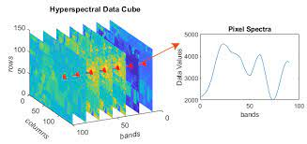

Slide 12
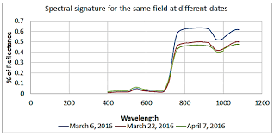
WHAT IS SPECTRAL SIGNATURE
Different surface types such as water, bare
ground and vegetation reflect radiation
differently in various channels. The radiation
reflected as a function of the wavelength is
called the spectral signature of the surface.

Slide 13
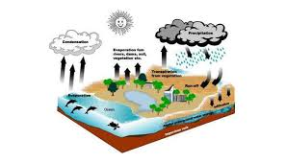
IMAGE INTERPRETATION REQUIRES AN
UNDERSTANDING OF SPECTRAL SIGNATURE
SPECTRAL SIGNATURE:
VEGETATION, WATER, SOIL

Slide 14

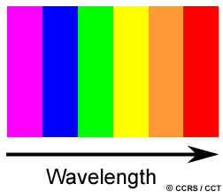
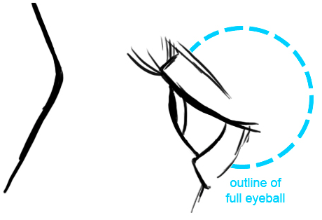

Amplitude
G
It absorbs energy from sunlight and helps converts it into chemical energy during the light dependent reactions of photosynthesis.
Strength of green light would depend upon vegetation type because of different concentration of chlorohyll

Slide 15
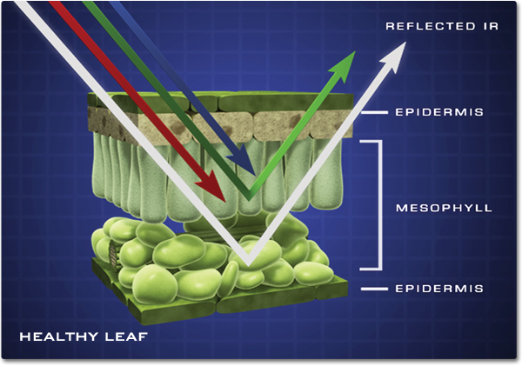
The word mesophyll comes from two Greek words; mesos, which means middle and phyllo meaning leaf.
mesophyll tissue is composed of two layers of cells (spongy and palisade cells), the mesophyll tissue in monocots is largely composed of isodiametric cells (cells that appear spherical or polyhedral in shape).

Slide 16
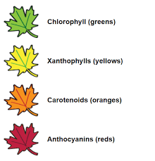
Photosynthetic Pigments
There are four different types of pigments present in leaves:
Chlorophyll a
Chlorophyll b
Xanthophylls
Carotenoids
Human pigment: Melalin. Which gives color to our skin
Hemoglobin gives color to blood

Slide 17
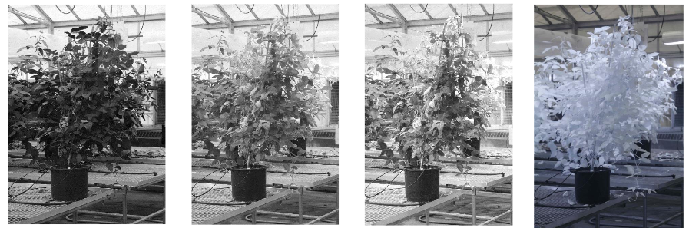
Blue
Green
Red
Infrared

Slide 18
WHAT IS TOTAL INTERNAL REFLECTION
In general, total internal reflection takes place at the boundary between two transparent media when a ray of light in a medium of higher index of refraction approaches the other medium at an angle of incidence greater than the critical angle.
The critical angle θ_{c} for a given combination of materials is thus
θc=sin−1(n2/n1)

Slide 19
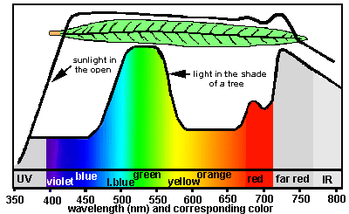
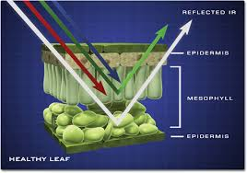
What is happening to invisible waves
Total Internal reflection

Slide 20
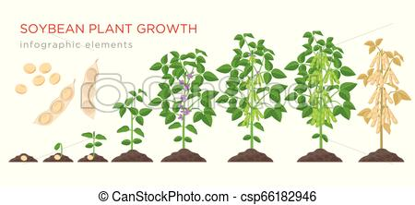
ABSORPTION OF LIGHT BY PLANT: Responsible for different colors in plant
In vegetation: Absorption of light is due to pigments

Slide 21
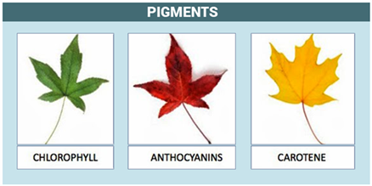
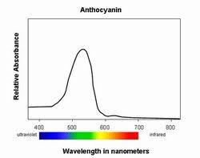
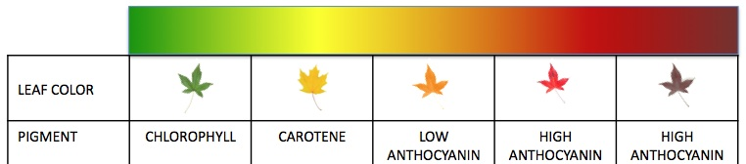
Other pigments

Slide 22
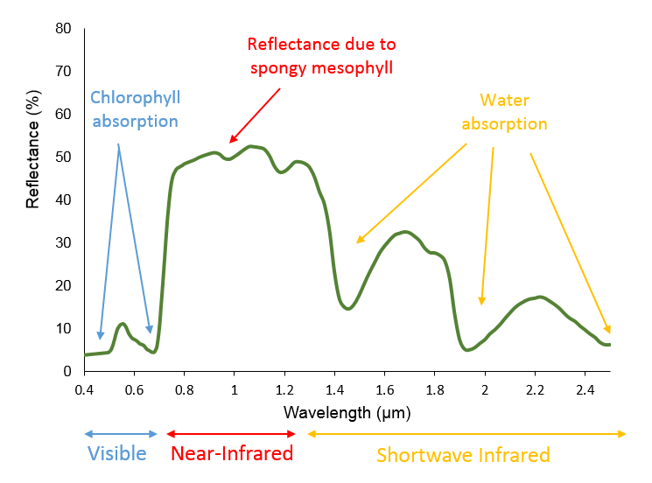
Vegetation Spectral Reflectance Curves
Vegetation has a unique spectral signature, but different types of vegetation differ in their reflectance. Plants that are stressed or diseased can also be identified by their distinct spectral signatures. The leaf pigments, cell structure and water content all impact the spectral reflectance of vegetation. For example deciduous trees have a higher reflectance in the near infrared compared to conifers.

Slide 23
Visible
In the visible bands the reflectance is relatively low as the majority of light is absorbed by the leaf pigments. Chlorophyll strongly absorbs energy in the blue and red wavelengths and reflects more green wavelengths. This is why healthy vegetation appears green.
Near Infrared
For healthy vegetation, the reflectance is much higher in the near infrared (NIR) region than in the visible region due to the cellular structure of the leaves, specifically the spongy mesophyll. Therefore healthy vegetation can be easily identified by the high NIR reflectance and generally low visible reflectance.
Shortwave Infrared
The reflectance in the shortwave infrared wavelengths is related to the water content of the vegetation and its structure. Water has strong absorption bands around 1.45, 1.95 and 2.50 µm . Outside these absorption bands in the SWIR region, reflectance of leaves generally increases when water content in the leaf decreases.

Slide 24
Pigments Responsible for Leaf color Change
The changing leaf colors you witness each year boil down to a few chemicals in the leaves. Some are pigments, some are by-products produced by the leaf, and other are produced only in the fall. Here are the culprits:
Chlorophyll
Carotenoids
Anthocyanins
Tannins
Chlorophyll ( reflects green)
The leaves of plants are responsible for absorbing light from the sun to convert it into energy for the plant.
it absorbs light; the pigment absorbs the blue and yellow and red wavelengths but not the green. The green is reflected back.
Carotenoids: ( yellow/brown)
when chlorophyll breaks down (and doesn’t get replaced in the leaves), the yellow colors start to appear
Anthocyanins produce the reds and purples that we see in maples, sumacs and dogwoods. They’re produced in the fall from a reaction with anthocyanidins. Tannins brown color are waste products, produced in the plants. E.g. tea .

Slide 25
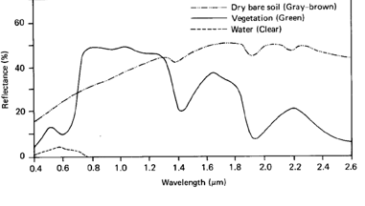
The reflection from bare ground increases slightly from the visible to the infrared range of the spectrum. There are great differences between different types of soil, dry and humid land. Different mineral compositions of the surface are also reflected in the spectral signature. In the illustration only an average curve for bare ground (soil) is shown.
Factors affecting soil signature are:
Soil moisture content
Soil Texture
Surface roughness
Iron oxide
Organic matter
Water absorption band: 1.4,1.9, 2.4 micro meter
Clay soil: Hydroxil ion absorption band at 1.4 and 2.2 micrometetr

Slide 26
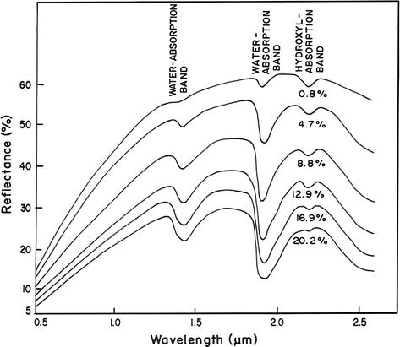

Slide 27
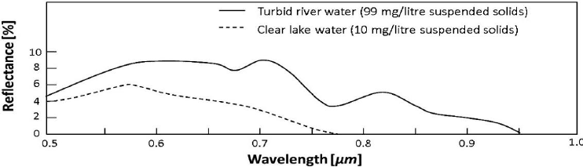
Generally, water only reflects in the visible light range. As water has almost no reflection in the near infrared range it is very distinct from other surfaces. Water surfaces will therefore be clearly delimited as dark areas (low pixel values) in images recorded in the near infrared range.

Slide 28
Vegetation
In general, healthy vegetation is a very good absorber of electromagnetic energy in the
visible region. Chlorophyll strongly absorbs light at wavelengths around 0.45 (blue) and 0.67
µm (red) and reflects strongly in green light, therefore our eyes perceive healthy vegetation
as green.
Healthy plants have a high reflectance in the near-infrared between 0.7 and 1.3 µm.
This is primarily due to healthy internal structure of plant leaves. As this internal structure
varies amongst different plant species, the near infrared wavelengths can be used to
discriminate between different plant species.
Water
In its liquid state, water has relatively low reflectance, with clear water having the greatest
reflectance in the blue portion of the visible part of the spectrum.
Water has high absorption and virtually no reflectance in near infrared wavelengths range
and beyond. Turbid water has a higher reflectance in the visible region than clear water.
This is also true for waters containing high chlorophyll concentrations.
Soil
Bare soil generally has an increasing reflectance, with greater reflectance in near-infrared
and shortwave infrared. Some of the factors affecting soil reflectance are:
Moisture content
Soil texture (proportion of sand, silt, and clay)
Surface roughness
Presence of iron oxide
Organic matter content

Slide 29
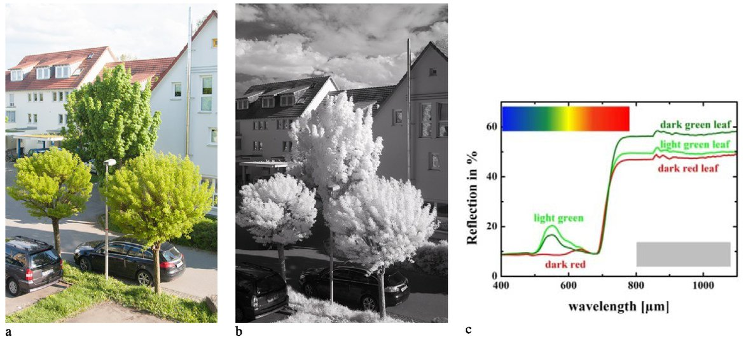

Slide 30
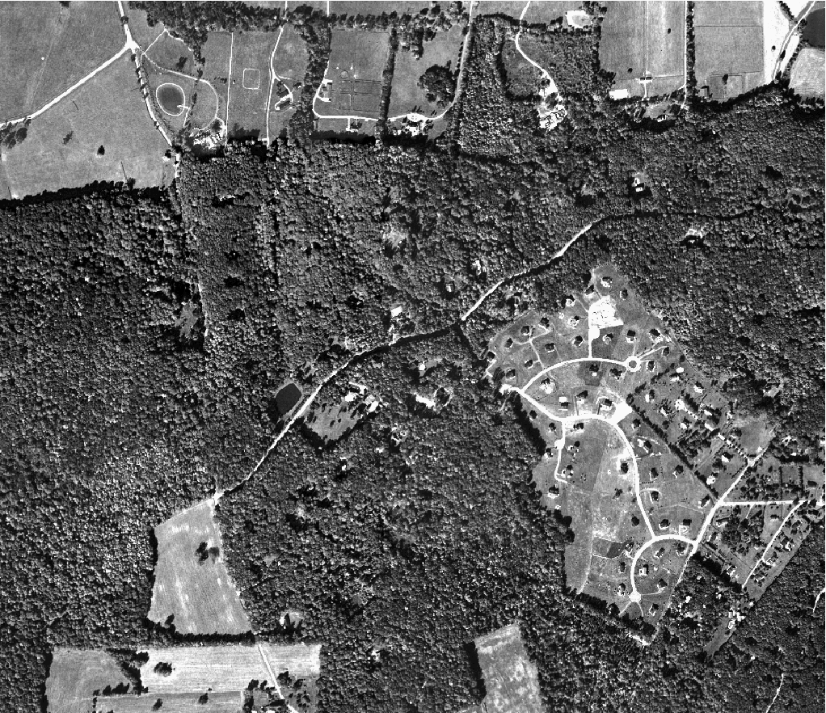
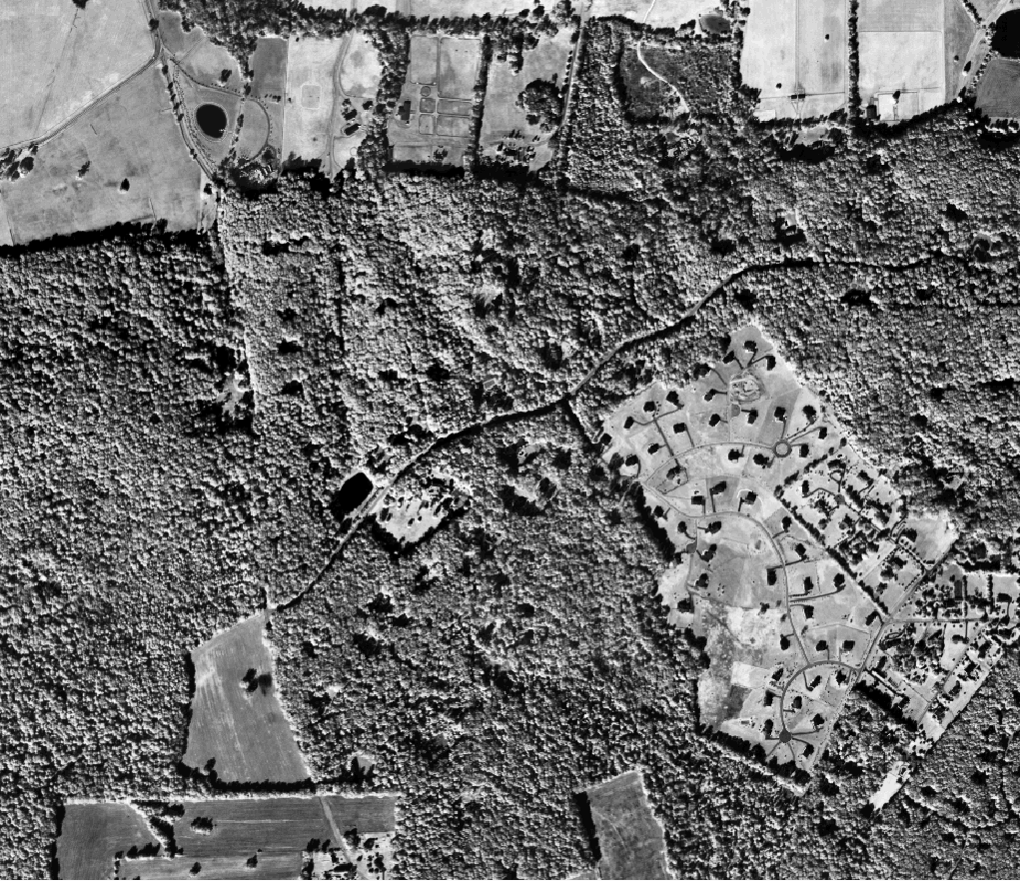
GREEN
NIR

Slide 31
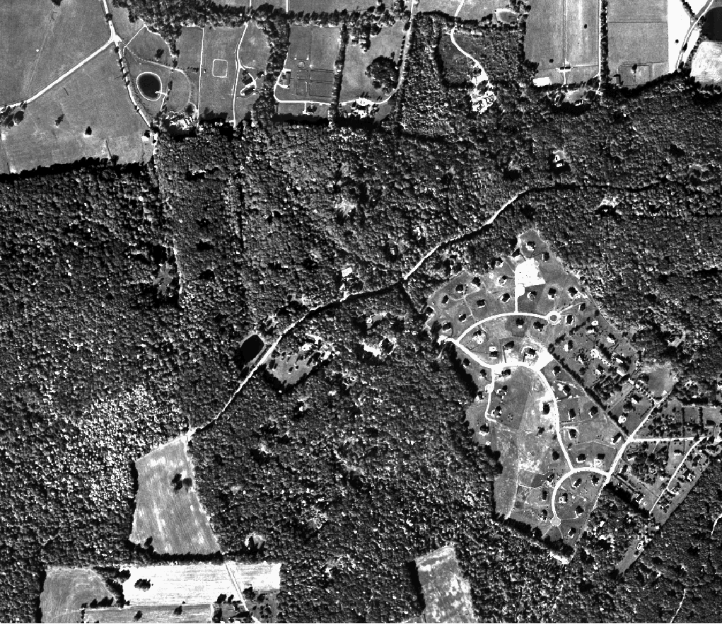

VISUALIOSATION of Single Band
Three bands, green, red and near infra-red
displayed separately as grayscale
Near-infra red
green
red

Slide 32
Display of Multispectral Image
NATURAL color composite
Bands
Applied to color
Resulting Image
Red
Green
Blue

Slide 33
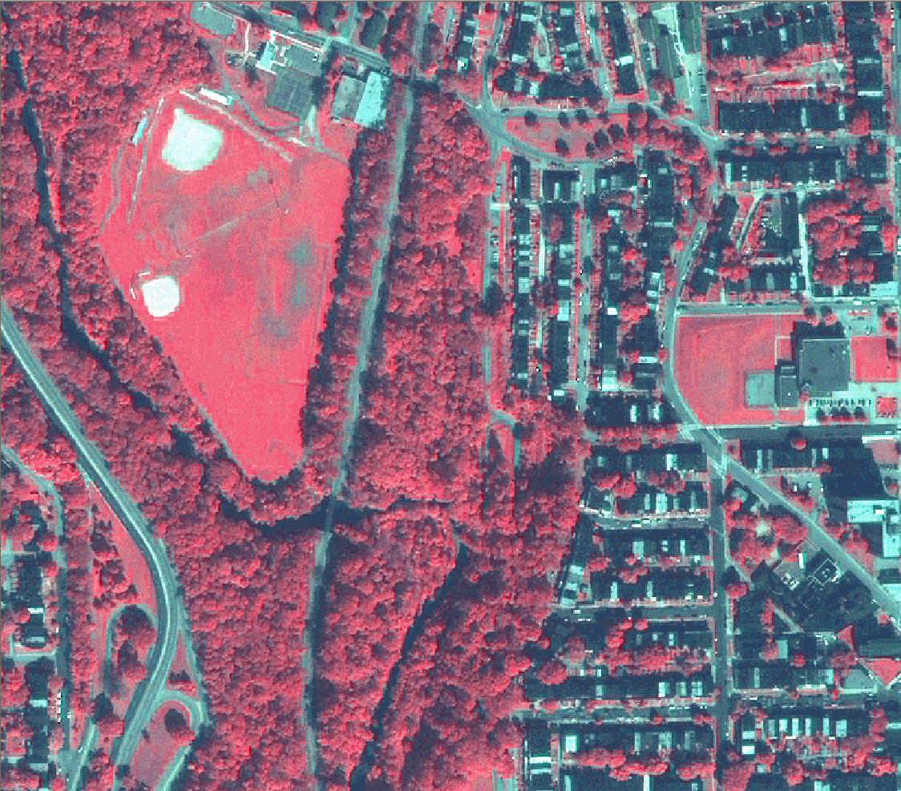
Display of Multispectral Image
False color composite
Bands
Applied to color
Resulting Image
Near Infrared
Red
Green

Slide 34
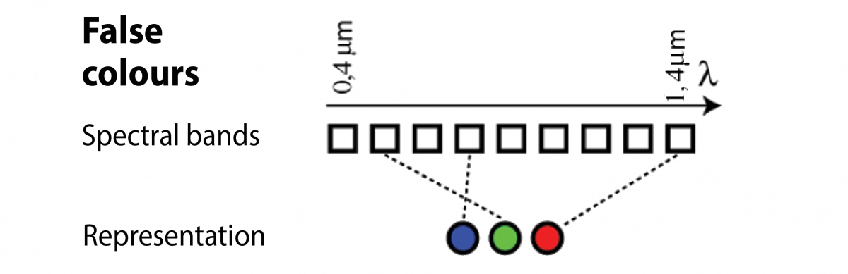

Slide 35
FALSE color composite

Slide 36
False color images are a representation of a multispectral image produced using any bands other than visible red, green and blue as the red, green and blue components of the display.
False color composites allow us to visualize wavelengths that the human eye can not see (i.e. near-infrared and beyond).

Slide 37
DATA SOURCES

Slide 38
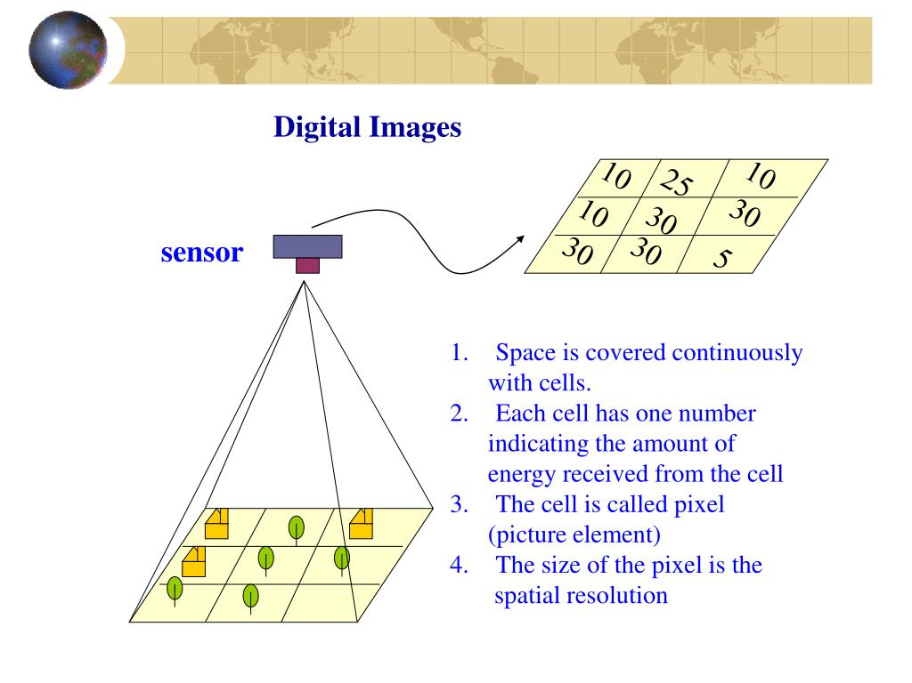
WHAT IS REMOTE SENSING DATA

Slide 40
Who will provide data: GOVT SPACE AGENCIES
Six government space agencies—the China National Space Administration (CNSA), the European Space Agency (ESA), the Indian Space Research Organisation (ISRO), the Japan Aerospace Exploration Agency (JAXA), the (US) National Aeronautics and Space Administration (NASA), and the Russian Federal Space Agency (RFSA)
List of space agencies with extraterrestrial landing capability
ESA, NASA, JAXA, ISRO, RFSA, CNSA
List of space agencies with human spaceflight capability
NASA, RFSA, CNSA,
72 different government agencies ( 195 countries)

Slide 41
DATA SOURCES
Free data sources
Government Agency ( NASA, ESA, JAXA, ISRO)
Private sector ( sample data)

Slide 42
IMPORTANT SATELLITES:
Landsat
SENTINEL-1 and 2
IRS/Resourcesat
ALOS

Slide 43
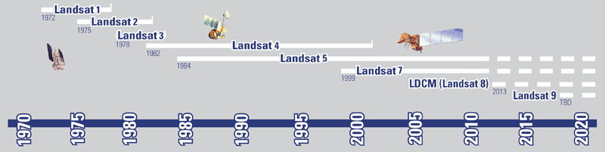
1.0 USGS Earth Explorer
https://earthexplorer.usgs.gov/
LANDSAT: – 40 years
ELEVATION: ASTER and SRTM
HYPERSPECTRAL: Hyperion
One of the best portal for fetching Remote sensing data from various satellites and aerial images, a wide range of search criteria . Full access to NASA’s Land Data Products and Services such as Hyperion’ s hyperspectral data, disperse Radar data and MODIS & AVHRR land surface reflectance.
Within, you will find open source datasets that were formed under collaboration with ISRO and ESA. This is Resourcesat-1 and 2 as well as Sentinel-2. Also you will find a lot of commercial hi-res sources like IKONOS-2 OrbView-3 and historical SPOT data.

Slide 44
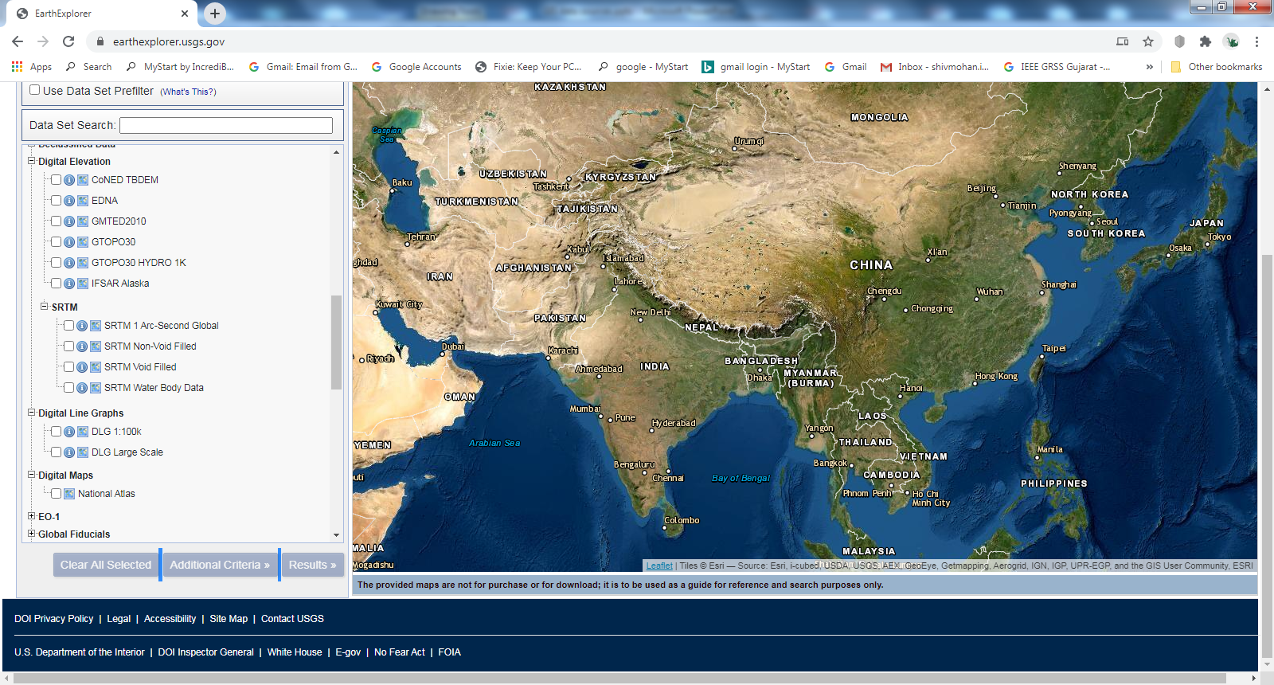
USGS Earth Explorer
https://earthexplorer.usgs.gov/

Slide 45
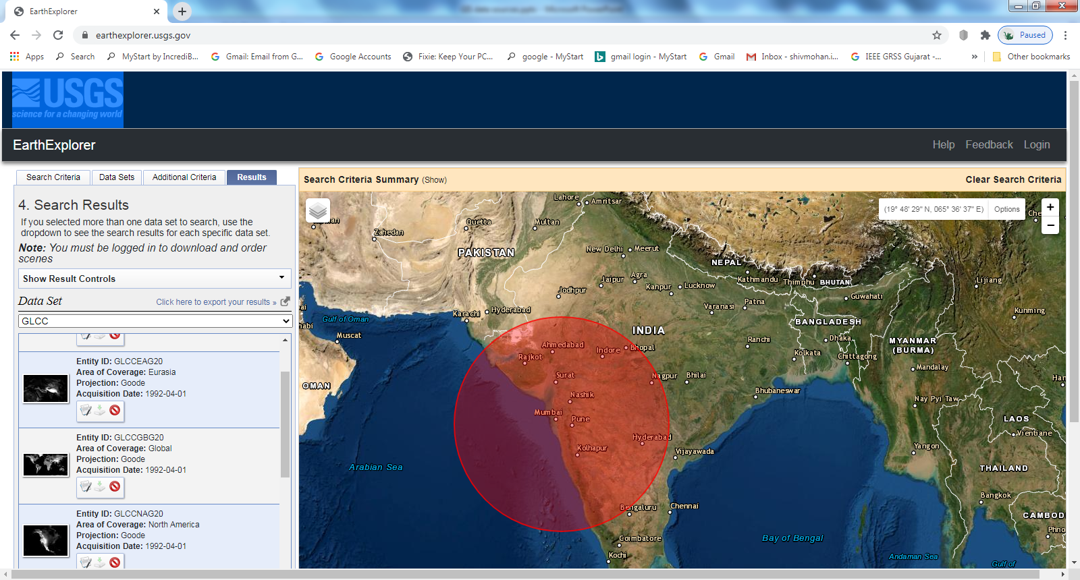

Slide 46
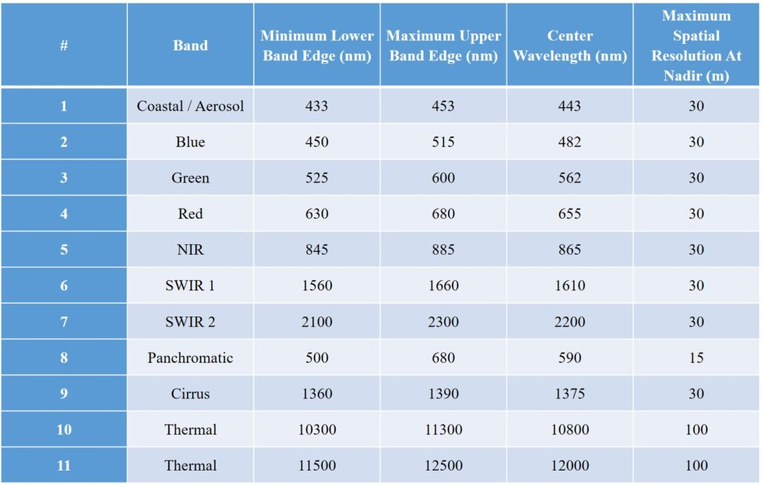
Landsat-9

Slide 47
2. Copernicus Open Access Hub (previously known as Sentinels Scientific Data Hub) provides complete, free and open access to Sentinel-1, Sentinel-2 and Sentinel-3 user products, starting from the In-Orbit Commissioning Review (IOCR). The ESA’s sentinel data is chasing the USGS Earth Explorer with more bands and better resolution.
Sentinel 1 A/B
C-band SAR, VV,VH mode
Sentinel-2

Slide 48
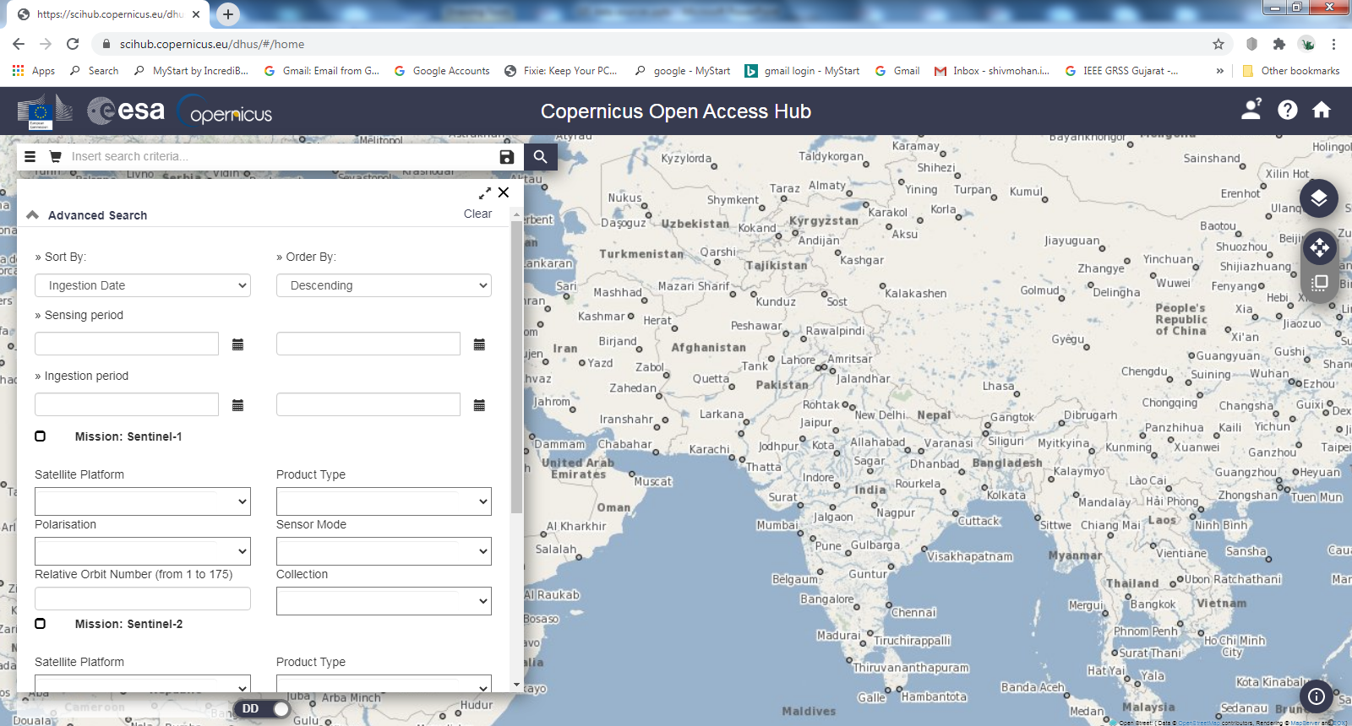
Copernicus Open Access Hub
https://scihub.copernicus.eu/dhus/#/home
SENTINEL-1: C-band SAR
SENTINEL- 2: 10 m resolution, spectral bands in

Slide 49
Past Satellites
Aryabhata, 1975
Bhaskara I, 1979
Bhaskara II, 1981
Rohini Series, 1980-83
SROSS Series, 1985-92
IRS-1A, 1988
IRS-P1, 1993
IRS-1B, 1991
IRS-P2, 1994
IRS-1C, 1995
IRS-P3, 1996
IRS-1D, 1997
IRS-P4, 1999 (Oceansat)
IRS-P6, 2003 (Resourcesat-1)
IRS-P5, 2005 (Cartosat-1)
IRS-P7, 2007 (Cartosat-2)
IRS-P6, 2011 (Resourcesat-2)
RISAT-1, 2012 (RISAT-1)
Name of the Satellite | Launch Date | Launch Vehicle | Orbit Type | Application
EOS-01 | 7-Nov-20 | PSLV-C49/EOS-01 | LEO | Disaster Management System, Earth Observation
RISAT-2BR1 | 11-Dec-19 | PSLV-C48/RISAT-2BR1 | LEO | Disaster Management System, Earth Observation
Cartosat-3 | 27-Nov-19 | PSLV-C47 / Cartosat-3 Mission | SSPO | Earth Observation
RISAT-2B | 22-May-19 | PSLV-C46 Mission | LEO | Disaster Management System, Earth Observation
HysIS | 29-Nov-18 | PSLV-C43 / HysIS Mission | SSPO | Earth Observation
Cartosat-2 Series Satellite | 12-Jan-18 | PSLV-C40/Cartosat-2 Series Satellite Mission | SSPO | Earth Observation
Cartosat-2 Series Satellite | 23-Jun-17 | PSLV-C38 / Cartosat-2 Series Satellite | SSPO | Earth Observation
Cartosat -2 Series Satellite | 15-Feb-17 | PSLV-C37 / Cartosat -2 Series Satellite | SSPO | Earth Observation
RESOURCESAT-2A | 7-Dec-16 | PSLV-C36 / RESOURCESAT-2A | SSPO | Earth Observation
SCATSAT-1 | 26-Sep-16 | PSLV-C35 / SCATSAT-1 | SSPO | Climate & Environment
INSAT-3DR | 8-Sep-16 | GSLV-F05 / INSAT-3DR | GSO | Climate & Environment, Disaster Management System
CARTOSAT-2 Series Satellite | 22-Jun-16 | PSLV-C34 / CARTOSAT-2 Series Satellite | SSPO | Earth Observation
INSAT-3D | 26-Jul-13 | Ariane-5 VA-214 | GSO | Climate & Environment, Disaster Management System
SARAL | 25-Feb-13 | PSLV-C20/SARAL | SSPO | Climate & Environment, Earth Observation
RISAT-1 | 26-Apr-12 | PSLV-C19/RISAT-1 | SSPO | Earth Observation
Megha-Tropiques | 12-Oct-11 | PSLV-C18/Megha-Tropiques | SSPO | Climate & Environment, Earth Observation

Slide 50
Name of the Satellite | Launch Date | Launch Vehicle | Orbit Type | Application
EOS-01 | 7-Nov-20 | PSLV-C49/EOS-01 | LEO | Disaster Management System, Earth Observation
RISAT-2BR1 | 11-Dec-19 | PSLV-C48/RISAT-2BR1 | LEO | Disaster Management System, Earth Observation
Cartosat-3 | 27-Nov-19 | PSLV-C47 / Cartosat-3 Mission | SSPO | Earth Observation
RISAT-2B | 22-May-19 | PSLV-C46 Mission | LEO | Disaster Management System, Earth Observation
HysIS | 29-Nov-18 | PSLV-C43 / HysIS Mission | SSPO | Earth Observation
Cartosat-2 Series Satellite | 12-Jan-18 | PSLV-C40/Cartosat-2 Series Satellite Mission | SSPO | Earth Observation
Cartosat-2 Series Satellite | 23-Jun-17 | PSLV-C38 / Cartosat-2 Series Satellite | SSPO | Earth Observation
Cartosat -2 Series Satellite | 15-Feb-17 | PSLV-C37 / Cartosat -2 Series Satellite | SSPO | Earth Observation
RESOURCESAT-2A | 7-Dec-16 | PSLV-C36 / RESOURCESAT-2A | SSPO | Earth Observation
SCATSAT-1 | 26-Sep-16 | PSLV-C35 / SCATSAT-1 | SSPO | Climate & Environment
INSAT-3DR | 8-Sep-16 | GSLV-F05 / INSAT-3DR | GSO | Climate & Environment, Disaster Management System
CARTOSAT-2 Series Satellite | 22-Jun-16 | PSLV-C34 / CARTOSAT-2 Series Satellite | SSPO | Earth Observation
INSAT-3D | 26-Jul-13 | Ariane-5 VA-214 | GSO | Climate & Environment, Disaster Management System
SARAL | 25-Feb-13 | PSLV-C20/SARAL | SSPO | Climate & Environment, Earth Observation
RISAT-1 | 26-Apr-12 | PSLV-C19/RISAT-1 | SSPO | Earth Observation
Megha-Tropiques | 12-Oct-11 | PSLV-C18/Megha-Tropiques | SSPO | Climate & Environment, Earth Observation

Slide 51
Name of the Satellite | Launch Date | Launch Vehicle | Orbit Type | Application
EOS-01 | 7-Nov-20 | PSLV-C49/EOS-01 | LEO | Disaster Management System, Earth Observation
RISAT-2BR1 | 11-Dec-19 | PSLV-C48/RISAT-2BR1 | LEO | Disaster Management System, Earth Observation
Cartosat-3 | 27-Nov-19 | PSLV-C47 / Cartosat-3 Mission | SSPO | Earth Observation
RISAT-2B | 22-May-19 | PSLV-C46 Mission | LEO | Disaster Management System, Earth Observation
HysIS | 29-Nov-18 | PSLV-C43 / HysIS Mission | SSPO | Earth Observation
Cartosat-2 Series Satellite | 12-Jan-18 | PSLV-C40/Cartosat-2 Series Satellite Mission | SSPO | Earth Observation
Cartosat-2 Series Satellite | 23-Jun-17 | PSLV-C38 / Cartosat-2 Series Satellite | SSPO | Earth Observation
Cartosat -2 Series Satellite | 15-Feb-17 | PSLV-C37 / Cartosat -2 Series Satellite | SSPO | Earth Observation
RESOURCESAT-2A | 7-Dec-16 | PSLV-C36 / RESOURCESAT-2A | SSPO | Earth Observation
SCATSAT-1 | 26-Sep-16 | PSLV-C35 / SCATSAT-1 | SSPO | Climate & Environment
INSAT-3DR | 8-Sep-16 | GSLV-F05 / INSAT-3DR | GSO | Climate & Environment, Disaster Management System
CARTOSAT-2 Series Satellite | 22-Jun-16 | PSLV-C34 / CARTOSAT-2 Series Satellite | SSPO | Earth Observation
INSAT-3D | 26-Jul-13 | Ariane-5 VA-214 | GSO | Climate & Environment, Disaster Management System
SARAL | 25-Feb-13 | PSLV-C20/SARAL | SSPO | Climate & Environment, Earth Observation
RISAT-1 | 26-Apr-12 | PSLV-C19/RISAT-1 | SSPO | Earth Observation
Megha-Tropiques | 12-Oct-11 | PSLV-C18/Megha-Tropiques | SSPO | Climate & Environment, Earth Observation

Slide 52
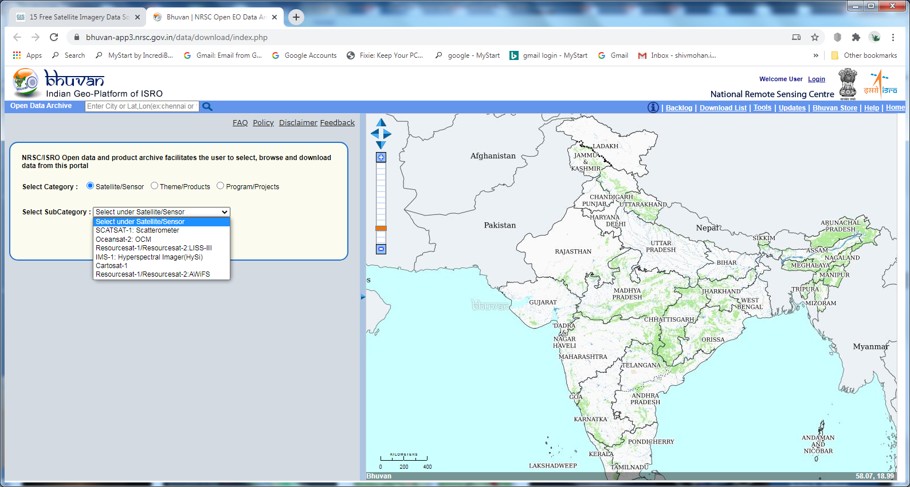
3.0 Bhuvan Indian Geo-Platform of ISRO
https://bhuvan-app3.nrsc.gov.in/data/download/index.php

Slide 53
QUESTION BANK
EXPLAIN SPECTRAL SIGNATURE OF VEGETATION,SOIL AND WATER
WHAT IS standard FALSE COLOR COMPOSITE
WHAT IS THE REASON OF HIGH IR SPECTRAL REFLECTACE IN PLANTS
https://nptel.ac.in/content/storage2/courses/105105110/pdf/m6l03.pdf
https://nptel.ac.in/courses/105/108/105108077/
https://nptel.ac.in/courses/105/108/105108077/

Slide 54
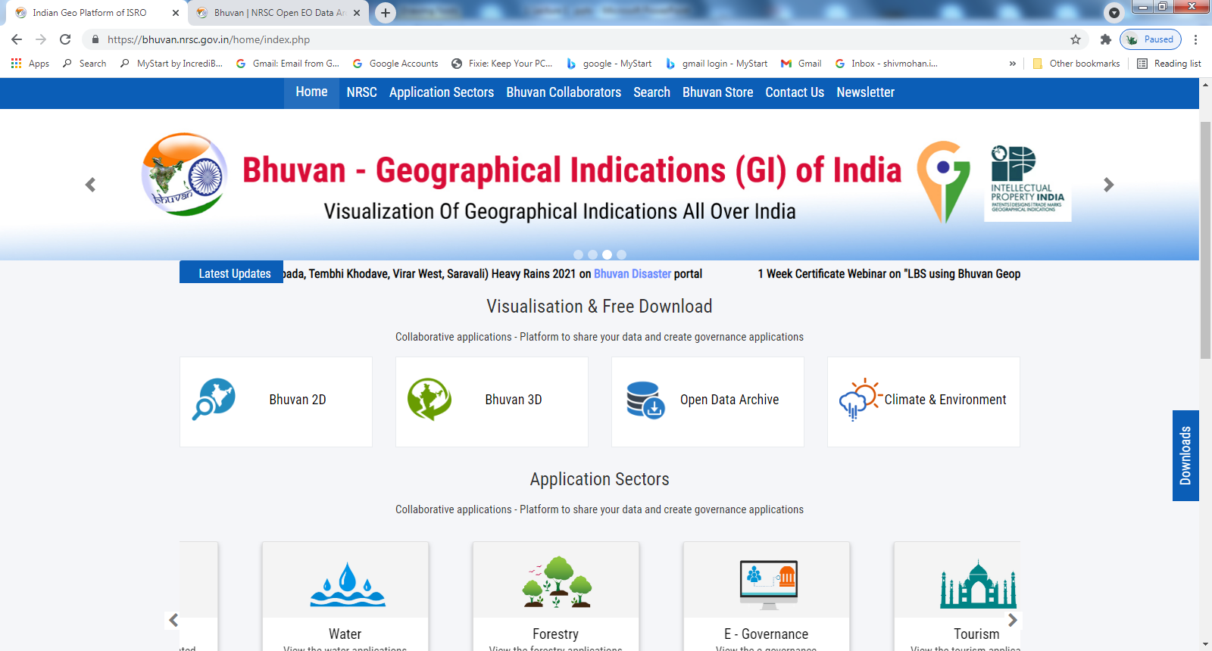
https://bhuvan.nrsc.gov.in/home/index.php
ISRO GEOPLATFORM

Slide 55
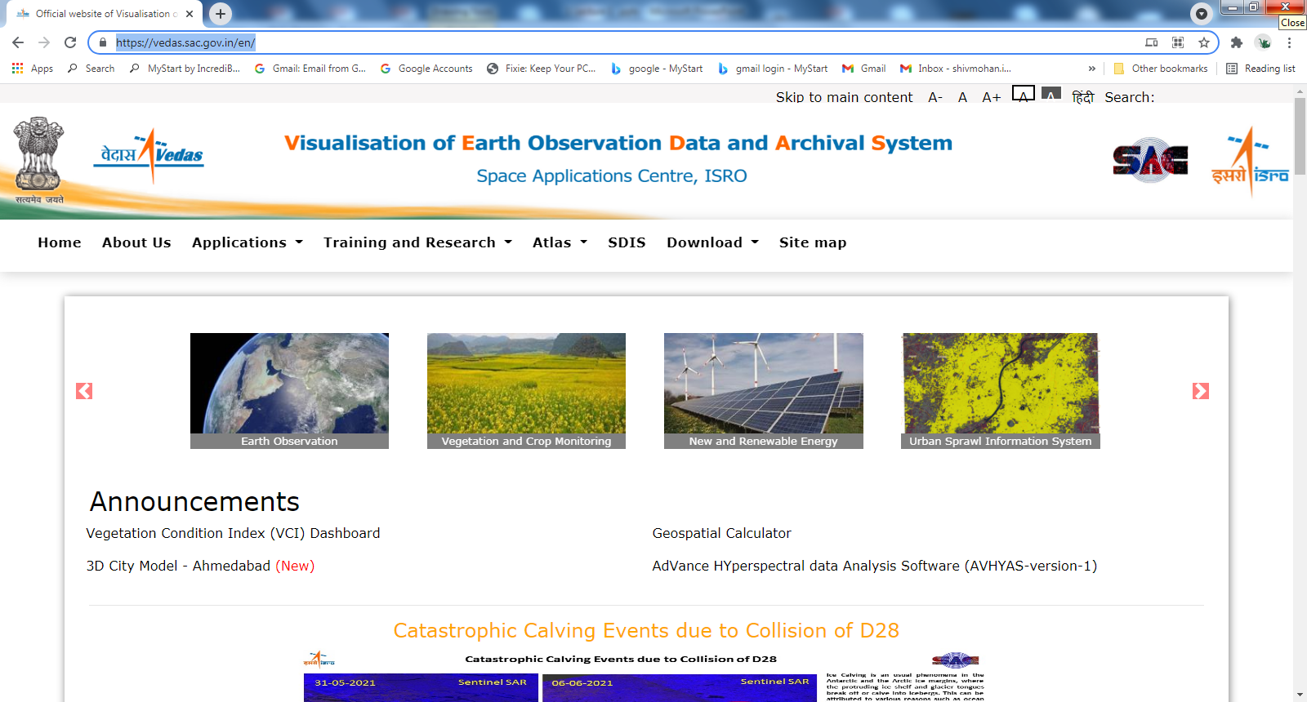
RS AND GIS APPLICATIONS IN GOVT DPARTMNT
SAC_ISRO
https://vedas.sac.gov.in/en/

Slide 56
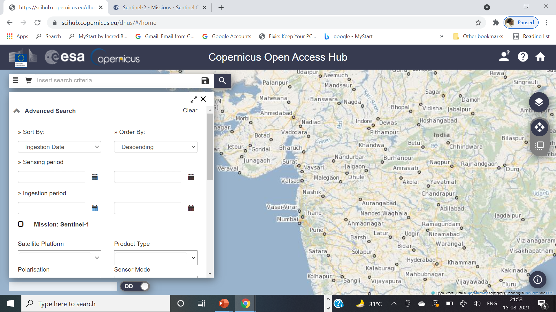
https://scihub.copernicus.eu/dhus/#/home

Slide 57


Slide 58

SENTINEL DATA HUB
https://scihub.copernicus.eu/
Launch: 23 June 2015:MSI covering 13 spectral bands (443–2190 nm), with a swath
width of 290 km and a spatial resolution of 10 m (four visible and near-infrared bands),
20 m (six red edge and shortwave infrared bands) and 60 m (three atmospheric
correction bands).
Sentinel 2B : July 2016

Slide 59
PRACTICE:
DATA DOWNLOAD : multispectral MSI
https://scihub.copernicus.eu/
EXPLORING SIGNATURES FROM SENTINEL-2 DATA
https://step.esa.int/main/download/snap-download/
Visualization of images
False color composite
color combination
SIGNATURE: water , vegetation and soil

Slide 60
QUESTION BANK
EXPLAIN SPECTRAL SIGNATURE OF VEGETATION,SOIL AND WATER
WHAT IS FALSE COLOR COMPOSITE
WHAT IS THE REASON OF HIGH SPECTRAL REFLECTACE IN PLANTS IN NIR REGION
Advantage of FCC
Advantages of multispectral Remote sensing
Additional Reading:
https://nptel.ac.in/content/storage2/courses/105105110/pdf/m6l03.pdf
https://nptel.ac.in/courses/105/108/105108077/
https://nptel.ac.in/courses/105/108/105108077/

